Slide 1
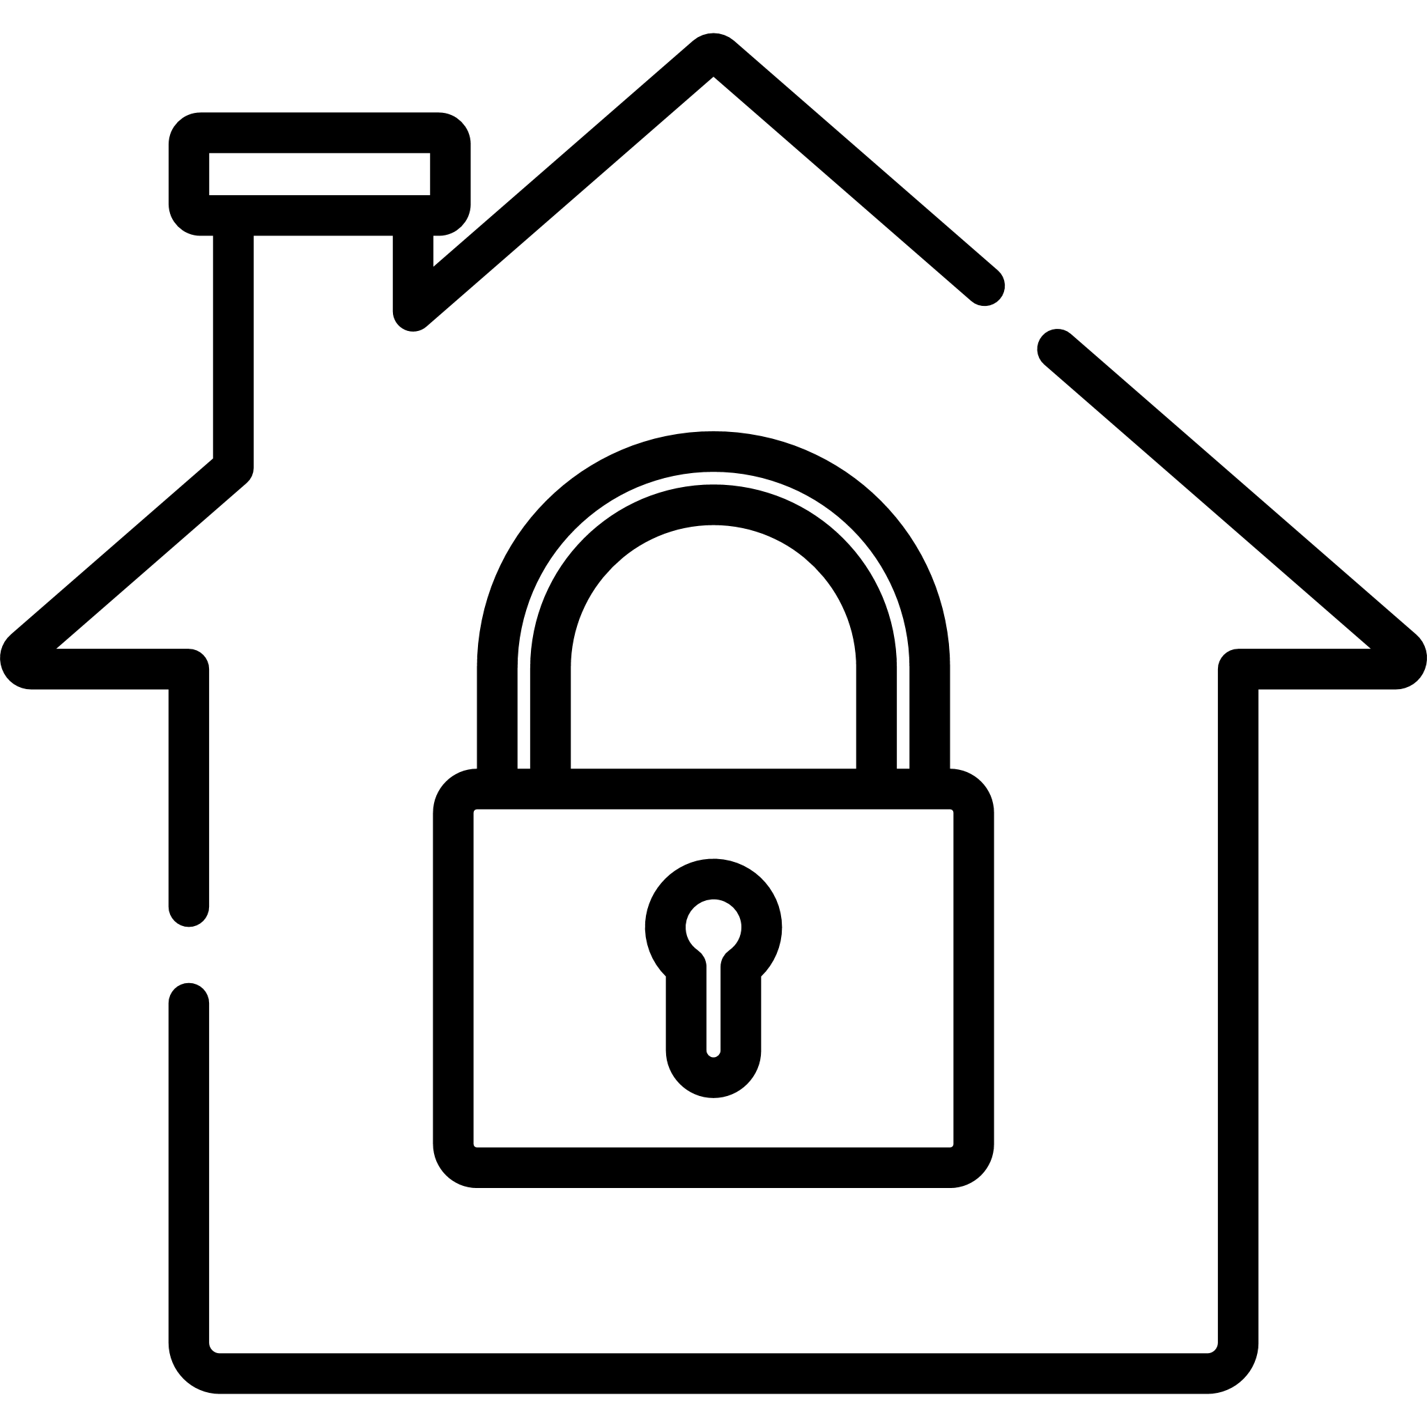
M&th
Moroni & tosi smart home
a.A 2020/2021

Slide 2

Application use case – smart home security
This application refers to a Smart Home with sensors and actuator for security :
Sensor Pir and DW for each room
Light controller and Alarm controller associated with sensors
Data Collector & Policy Manager application for managment of the behavior of every deployment of the smart building

Slide 3


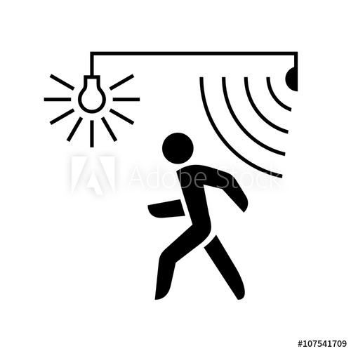

REsources
DATA COLLECTOR
SENSOR PIR AND DW
LIGHT ACTUATOR
ALARM ACTUATOR

Slide 4
Architecture and protocol used
Data Collector and Policy Manager is located locally.
PRO:
Greater flexibily and freedom in local software management
Security of having all the necessary data and software on site
Simple to implement (no communication between different nodes) and quick responses
CONS:
Additional costs for update and for maintenance
Short scalability

Slide 5
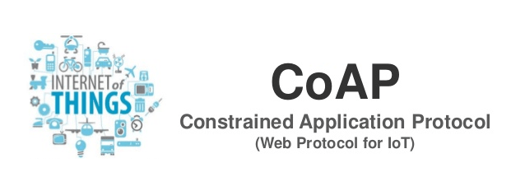
Architecture and protocol used
We implemented communication between nodes and devices with CoaP protocol
They are connected to the network through the use of the wi-fi protocol

Slide 6
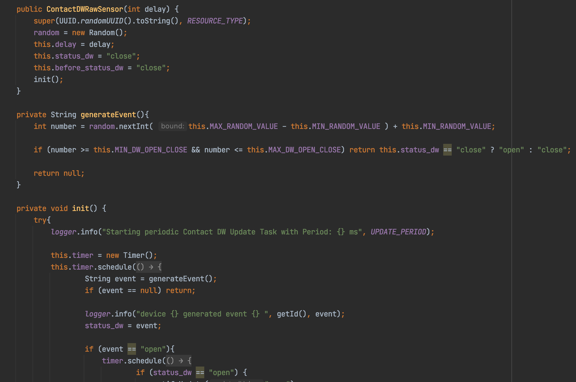
COAP sensors

Slide 7
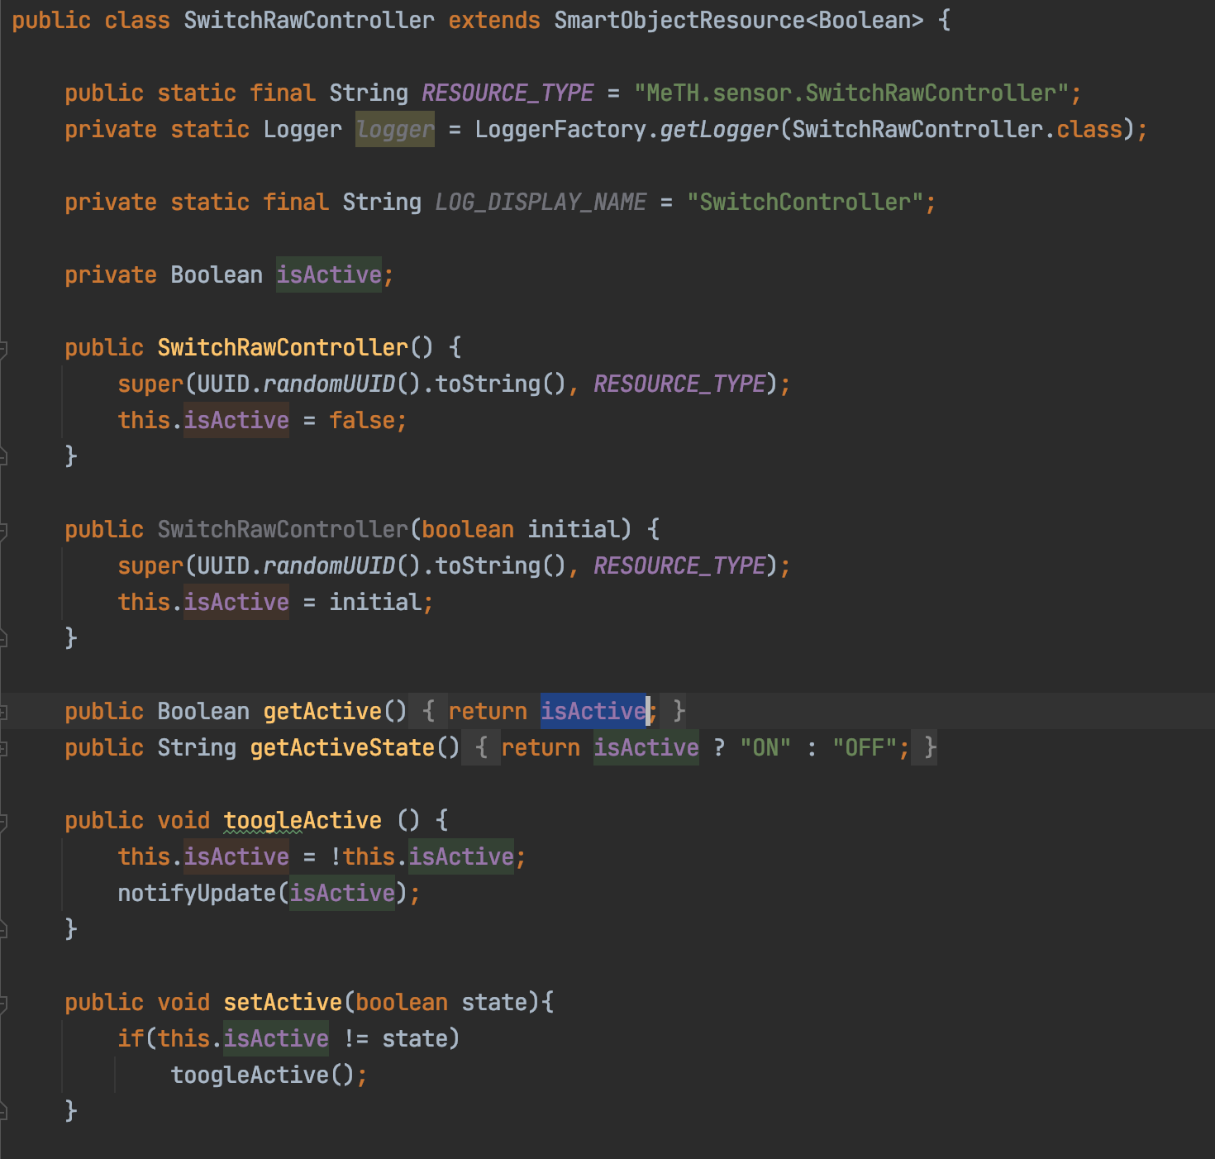
COAP sensors

Slide 8
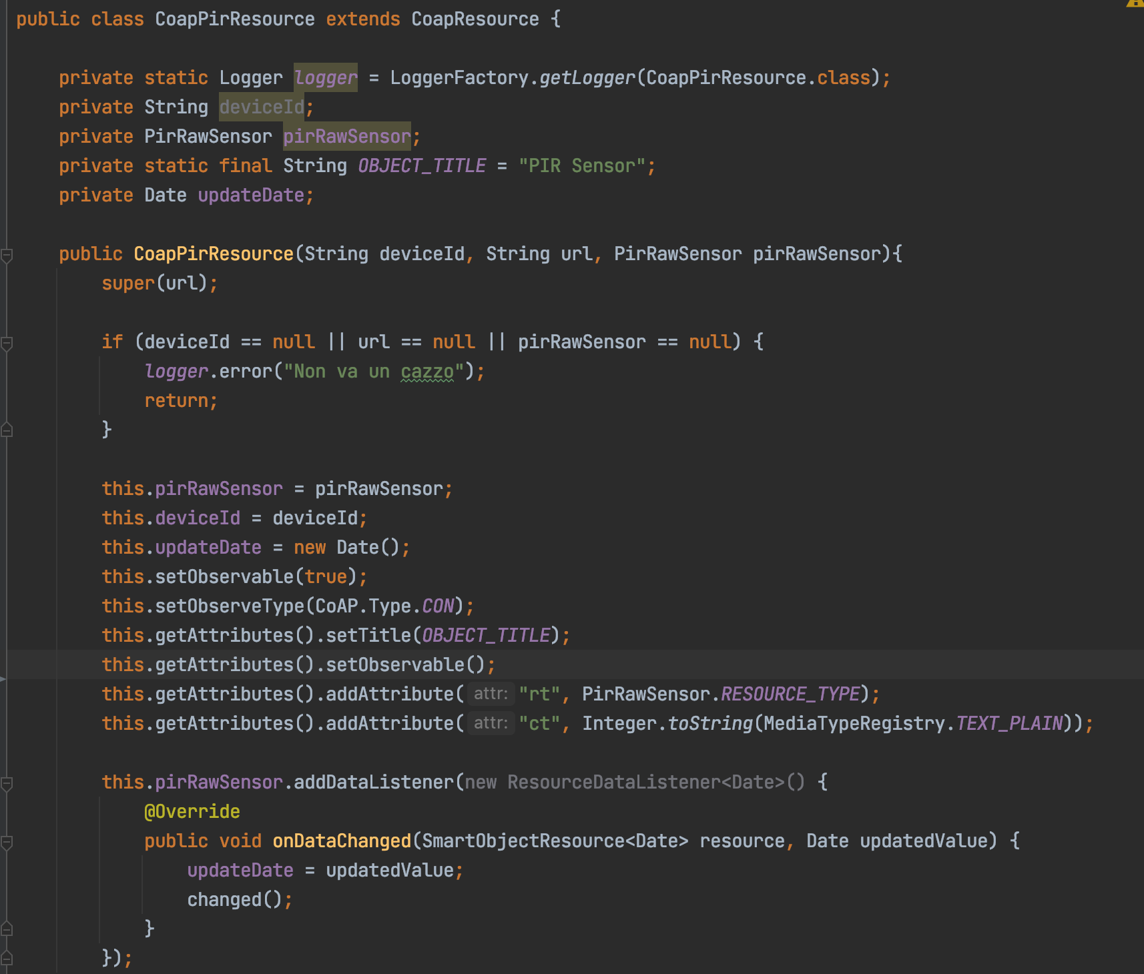
COAP resources

Slide 9
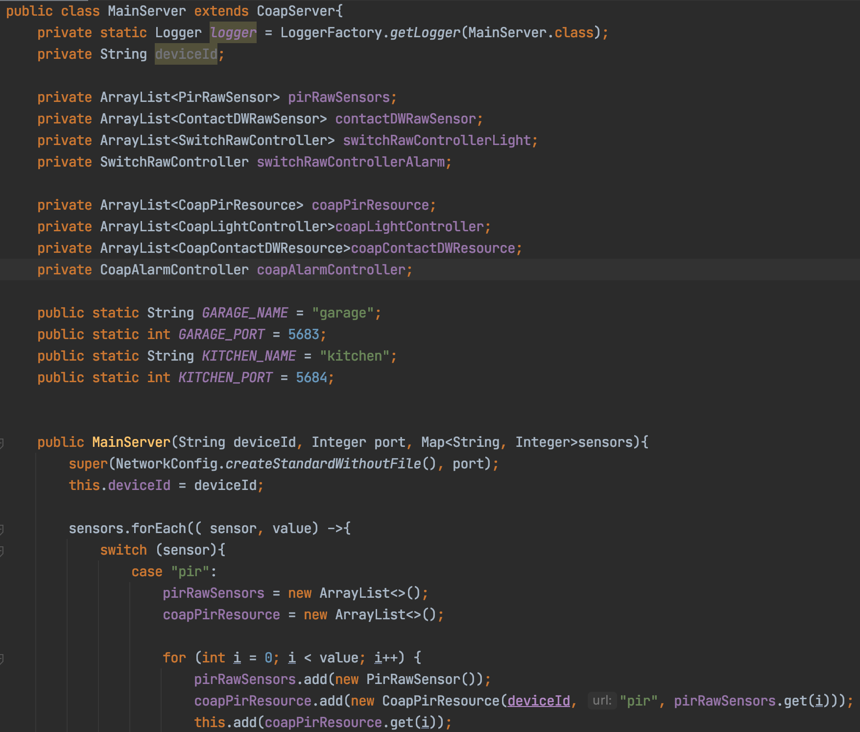
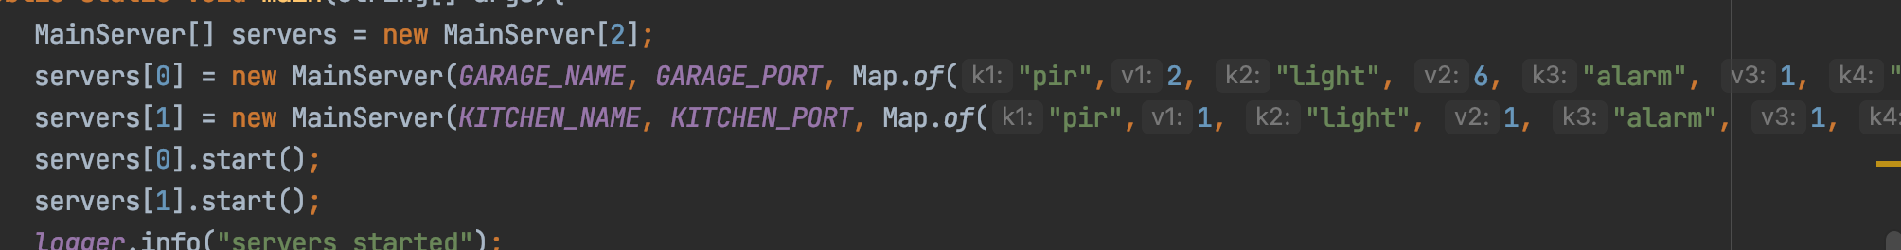
COAp data collector

Slide 10
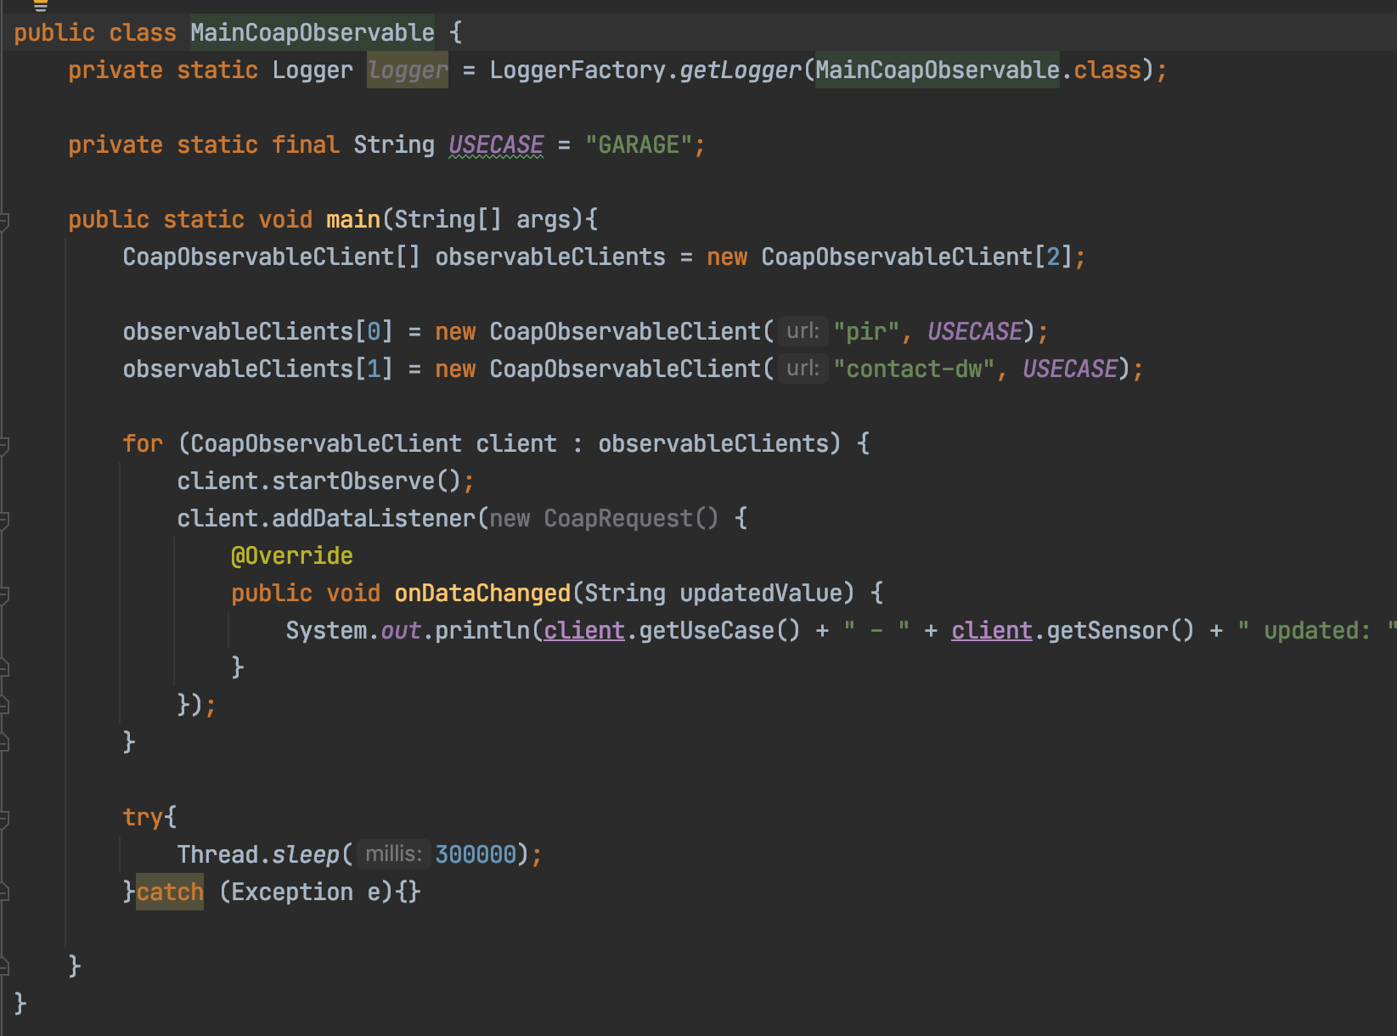
COAP obs client

Slide 11
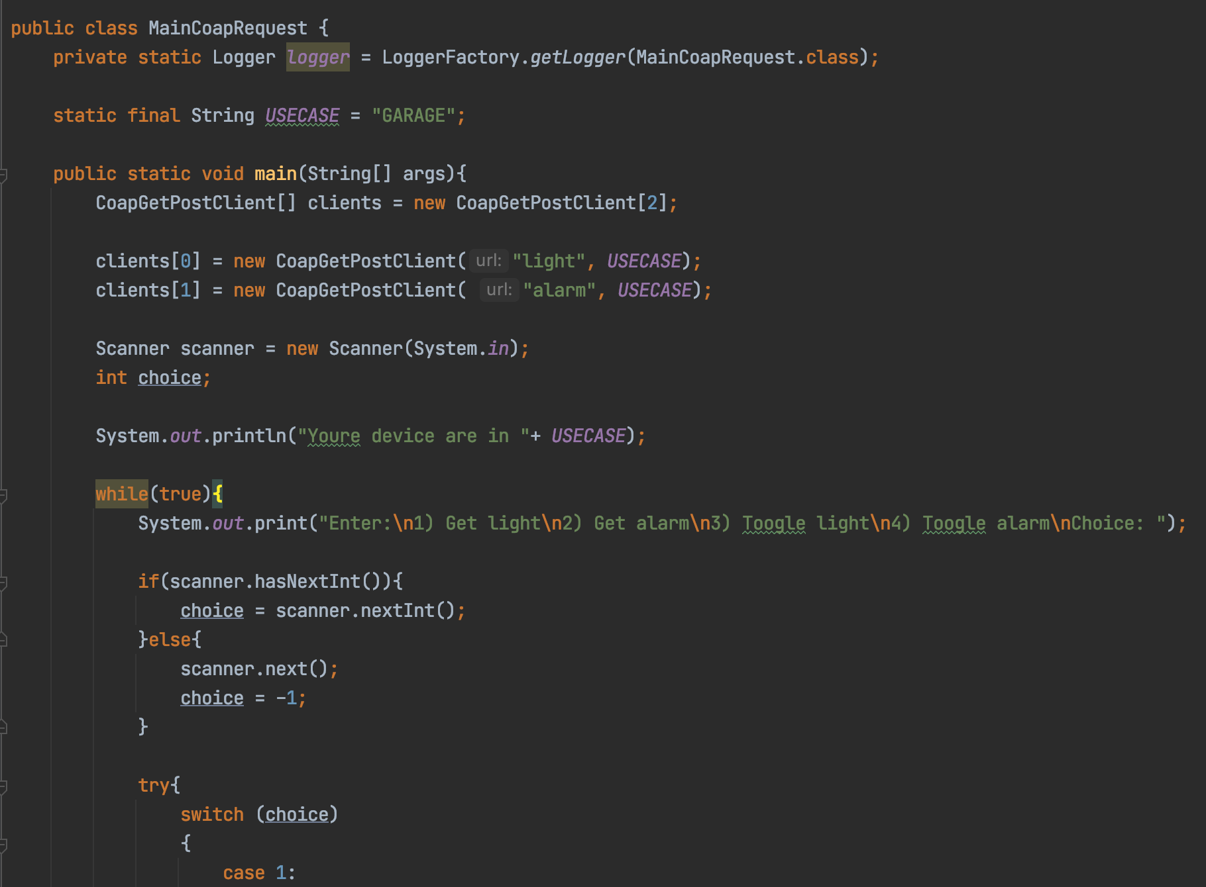
COAP request client

Slide 12

MeTh
Moroni & Tosi smart Home

